Slide 1


Retrieval-Augmented Generation (RAG)
Chatbot
Mithun Senthil V
22PD22

Slide 2
Introduction
In the ever-evolving digital landscape, Multi-Modal AI is revolutionizing the way we interact with information.
By integrating various data types text, images, audio, and more. Multi-Modal AI systems enable more sophisticated and context-aware responses.
This presentation delves into the innovative application of Multi-Modal AI in enhancing Retrieval-Augmented Generation (RAG) systems, ultimately driving more intelligent and dynamic user experiences.

Slide 3

PROJECT GOALS
1. Multimodal Chatbot purpose mainly as an assistant
2. Chatbot must fetch the relevant text and images from the knowledge base for the user query and present it, with minimal latency and hallucination

Slide 4

TECH STACK
Language: Python
Technology: RAG
Embedding model: text-embedding-004
image model: gemini-2.0-flash
Chat model: Llama3-70b-8192
image processing: OpenCV
Vector DB: Pinecone Db
Note: No frameworks like langchian is used.

Slide 5
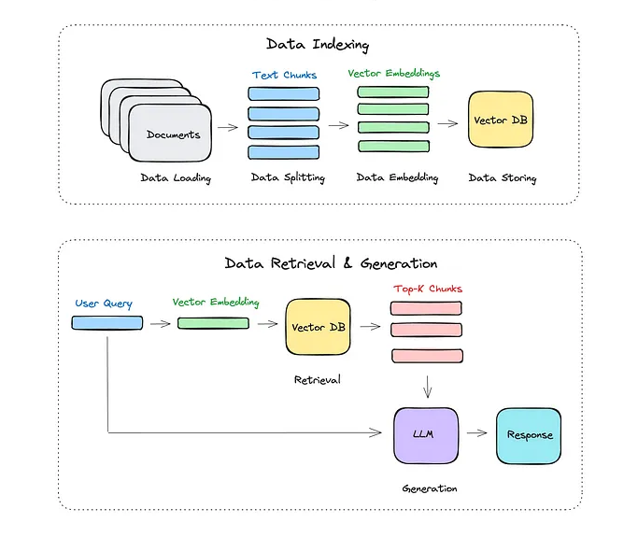
RAG PIPELINE
Vector Embedding : They are numerical representations of data points.
Vector Database : It is a specialized data management system designed to store, manage, and index high-dimensional vector embeddings.
Chunking : A process by which small individual pieces of information are bound together to create a meaningful whole in memory.
LLM : A large language model (LLM) is a type of artificial intelligence (AI) system capable of understanding, generating, and processing human language by training on vast amounts of text data.
Prompt : The input or instruction given to the model to elicit a specific response or output.

Slide 6
Project Overview
This Retrieval-Augmented Generation (RAG) Chatbot uses Django framework to build a full-stack web application.
Implemented a MultiModal RAG system, that queries from different document types like pdf, docs, csv, image and video, used different processing techniques for different document types.
Knowledge Base:
Students Grading Dataset [CSV File]
Data Incident Management [PDF File]
Luxury Cars Image Dataset [Image Files]
Linear Regression in 3 Minutes [Video File]
Introduction to Machine Learning [DOC File]
The user can also upload their own data into the system and can be queried from that also.

Slide 7
User Query Processing
This is handled by rag_bot.py [rag\Utils\rag_bot.py]
The RAGbot class has two methods retrieve_context() and normal_response()
The retrieve_context() will take the user query as its input, the user query is embedding and searched in pinecone for all the related context and the function returns top 4 the matches.
The normal_response() will take the user query and matches from the db and extracts all the context from the matches and feeds it to the llama3-70b-8192 used via groq API to generate response for the user query. Used prompt engineering for optimal response.

Slide 8
Csv Query Processing
If a csv content is present in the related context for the user query it will be processed differently.
The summary of the csv along with the user query will be given to a LLM which will produce a pandas code for the user query, which will be executed and the pandas output is stored.
The pandas code, pandas output along, csv summary along with the user query will be given to another LLM which will give a final response to the user query.

Slide 9
Insert file Processing
Each file type in handled differently to extract the context. Every file processing module is written as a class for modularity.
PDF File handling:
This is handled by process_pdf.py [rag\Utils\process_pdf.py]
Main function extract_content() and process_pdf()
The extract_content() read the pdf and extracts all the text, tables and images.
The process_pdf() chunks the content in the file each image and tables is a separate chunk and the text is splited using _split_text() function with chunk_size=1000, chunk_overlap=300
Finally all these chunks are embedded upserted along with some metadata into vector DB (pinecone)

Slide 10
Docx File handling:
This is handled by process_doc.py [rag\Utils\process_doc.py]
Main function extract_content() and process_documents()
The extract_content() read the Doc or txt file and extracts all the text, tables.
The process_documents() chunks the content in the file each image and tables is a separate chunk and the text is splited using _split_text() function with chunk_size=1000, chunk_overlap=200
Finally all these chunks are embedded upserted along with some metadata into vector DB (pinecone)
Csv File handling:
This is handled by process_csv.py [rag\Utils\process_csv.py]
Main function generate_csv_summary() and process_csv()
The generate_csv_summary() read the csv file and extracts all the important information.
The process_csv() create embedding for the csv summary and it is upserted into the vector DB (pinecone)

Slide 11
Image File handling:
This is handled by process_image.py [rag\Utils\process_ image.py]
Main function generate_image_summary() and process_image()
The optimize_image() is used to reduce the size of the image for storing, the generate_image_summary() is used to create a summary for the image using the gemini-2.0-flash which is the optimal model for image summarization.
The image summary is embedded and upserted in the vector DB along with the metadata which contains the base64 encoding of the image file. This base64 encoding will be later used for displaying the image when required.

Slide 12
Video File handling:
This is handled by process_video.py [rag\Utils\process_video.py]
The main functions process_video() and process_frames_with_transcript() handle video processing.
The extract_frames() is used to extract key frames from the video, while transcribe_audio() is used to extract audio transcribe and these both are given to process_frames_with_transcript() which creates context with gemini-2.0-flash using both audio and frames.
Finally all these are embedded upserted along with some metadata into vector DB (pinecone).

Slide 13
Outputs

Slide 14
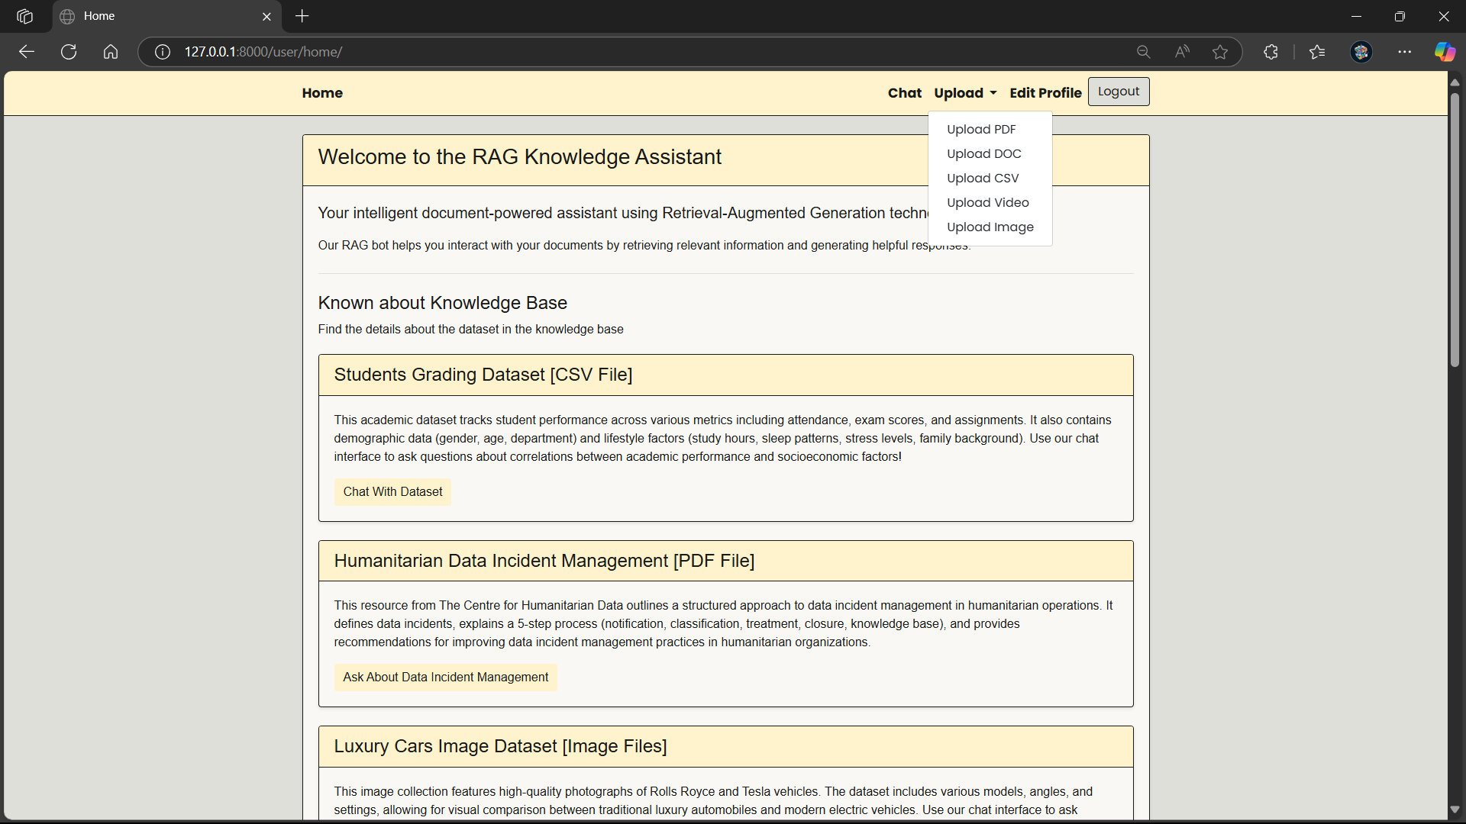
Description of the data in the knowledge base is given
Different types of documents can be upload here, which will be processed and stored in pinecone (Vector DB)

Slide 15
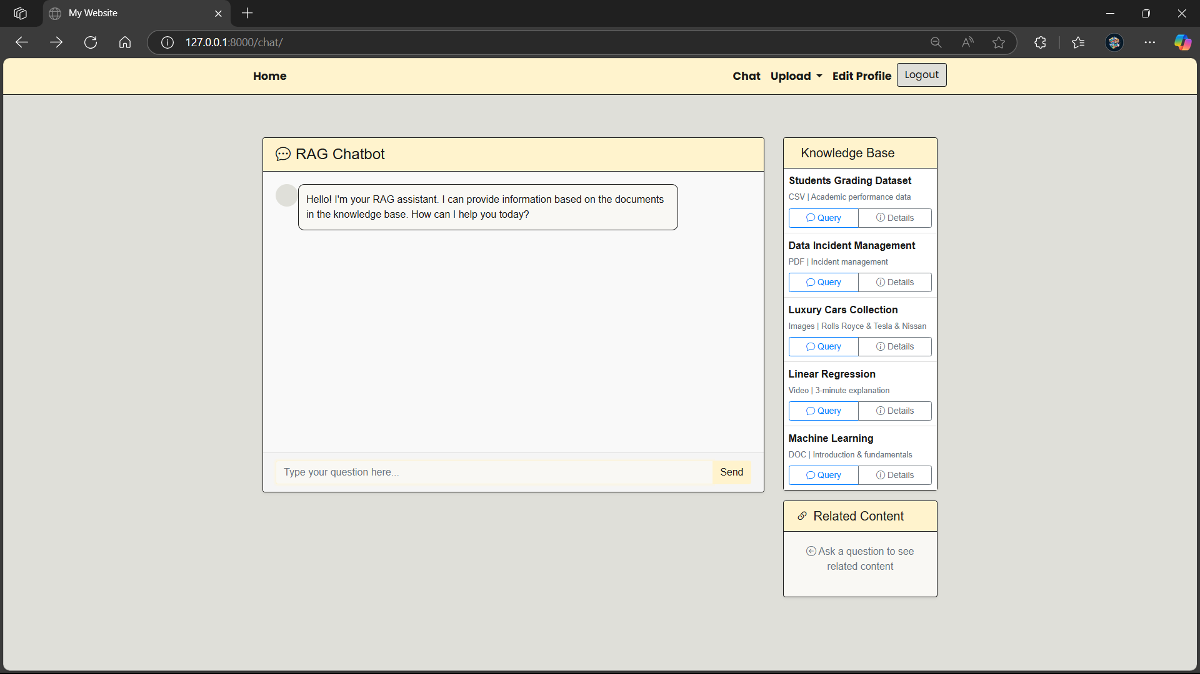
Click on the query button to know about the data
Click on the details button to view the description about the data

Slide 16
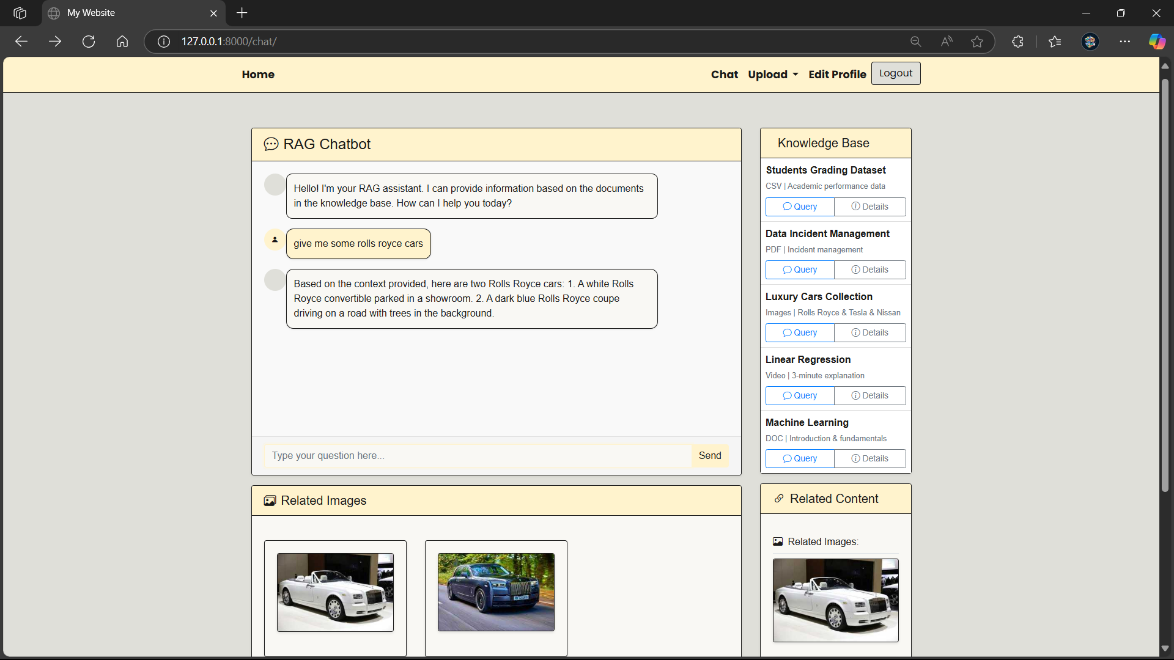
Gives you image if the context has images otherwise it will be blank
Gives you all the related content for the user query, which will be used for answering user query

Slide 17
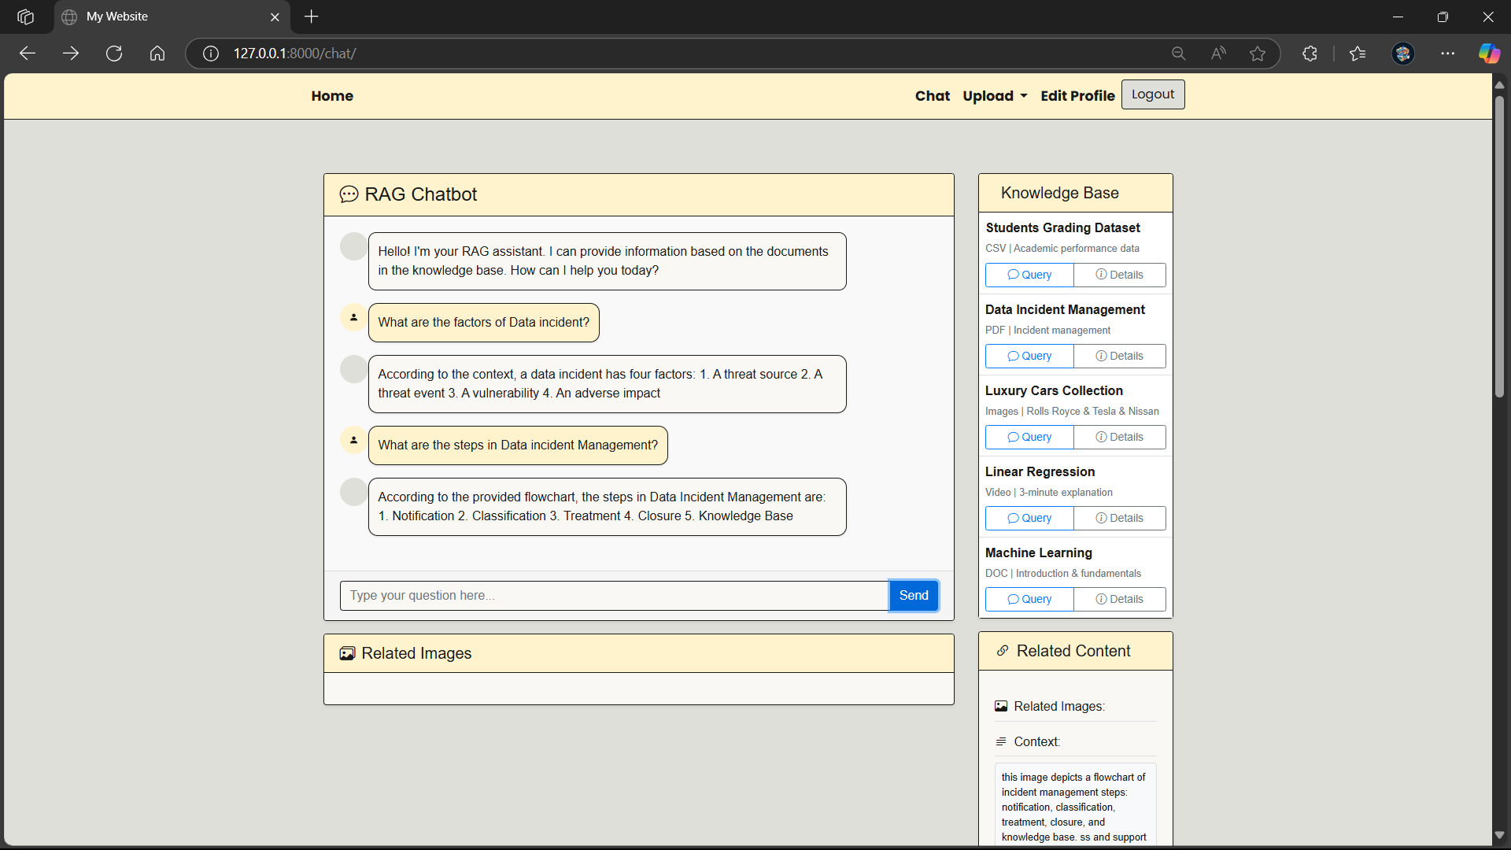
Query from Pdf Data

Slide 18
Query from Image Data

Slide 19
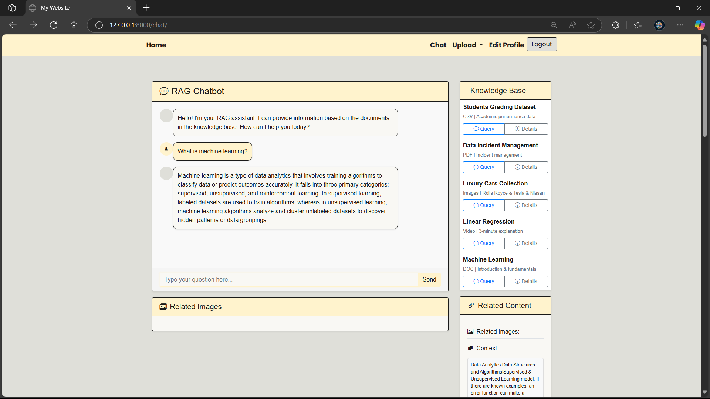
Query from Docx Data

Slide 20
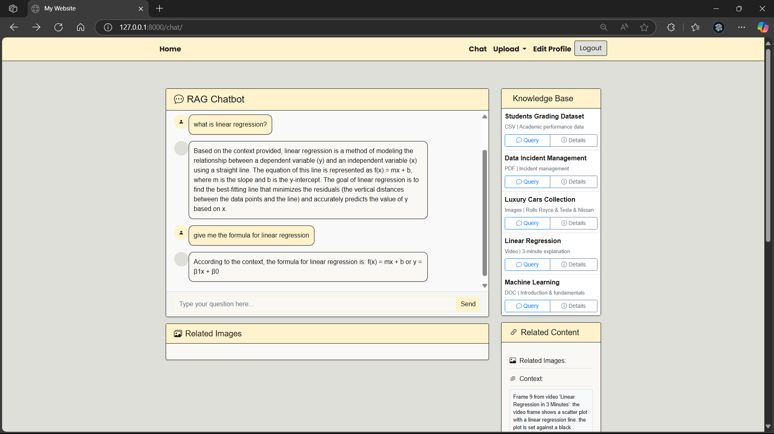
Query from Video Data

Slide 21
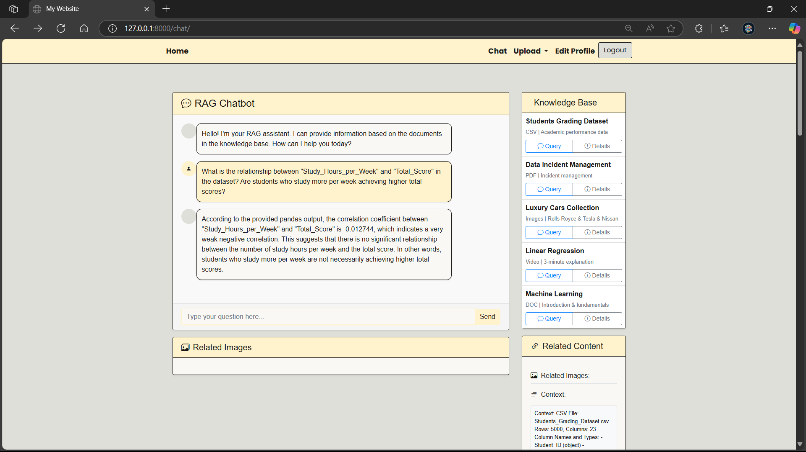
Query from CSV Data

Slide 22
Thank you

